Slide 1
Social Change & Campaigning
with the Sheila McKechnie Foundation
2019-2020

Slide 2
Contents
In this slide deck you will find:
What the Social Change & Campaigning Learning Cluster is
Aims of the cluster
Who took part
What we learnt
New skills & knowledge
Next steps for participants
Points for further discussion
Links to extra resources: guides, tools, podcasts
Notes:
Handouts from the cluster: https://localtrust.org.uk/wp-content/uploads/2020/03/Handouts-Social-change-cluster.pdf

Slide 3
About Big Local learning clusters
Learning clusters were developed so that a group of residents from across Big Local areas could go beyond the limits of a one-day event, meeting several times over the course of a year to get to know each other better and go deeper into a topic – whether this is a specific theme or skill.
Clusters are designed to combine peer learning and inspiring stories from participants with guidance from experts who could take learning to the next level.
Lessons can also be shared with partnership members and other communities who do not attend, contributing to improved understanding of a topic area.

Slide 4
About the Social Change & Campaigning Learning Cluster
SMK were invited to run a workshop at a Big Local event in June 2018, introducing social change and campaigning to the local groups. The session was well attended and there was a clear appetite for more support on this theme. Subsequently the Local Trust decided to run a learning cluster on Social Change and Campaigning.
The Learning Cluster ran for five days between February 2019 and January 2020.
It introduced SMK’s ‘social power’ model and built participants knowledge and skills in key areas they would need to press for transformative social change.

Slide 5
Developing the cluster
Local Trust listened to Big Local groups about what areas they wanted support in.
They said it should address how partnerships can inspire and encourage other people to take action, whether that’s other people and organisations within an area or policy makers and elected officials.
SMK also conducted telephone interviews with those who signed up to the Learning Cluster, which informed the final programme design.

Slide 6
Aims of the cluster
Groups will understand social change and how it happens
Groups will have the confidence, knowledge and skills to campaign effectively in their local area
Participants will be able to engage with the wider community and decision makers effectively to achieve change in their area
Participants will have clear plans and strategies which lead to action being taken in their area

Slide 7
Cluster participants
Big Local area | Region
Aberfeldy | London
Barrowcliff | Yorkshire and the Humber
Big Local Broad Green | London
Bradley | North Yorkshire
Collyhurst | North West
Conniburrow | South East
Keighley Valley | Yorkshire and the Humber
Newington, Ramsgate | South East
Selby Town | North Yorkshire
SO18 | South East
William Morris | London
Woodland Speaks | Yorkshire and the Humber

Slide 8
What we learnt
Strategy: how change happens, our right to make change and the tools we can use to plan
Influence: getting under the skin of decision-makers, ways to engage with power, mobilizing communities & building alliances
Spreading the word: the power of stories, understanding who our audiences are, and using personal experience
Keeping up momentum: setting goals, keeping our own energy up and developing our own voices

Slide 9
Meeting 1: strategy
How change happens: including the Social Change Grid
Campaigning & compliance: being confident in your right and legitimacy to campaign for change
Tools to plan your strategy: identifying problems, solutions, and opportunities, setting objectives, planning for flexibility
27 & 28 February 2019, London
Trainers: Sue Tibballs (SMK Chief Executive) and Chloe Hardy (SMK Director of Policy & Communication)
Guest speakers: Cllr Catherine Rose (Campaign to Save Dulwich Hamlet FC) & Lucie Russell (Joseph Rowntree Foundation)
Notes:
The story of Dulwich Hamlet FC - https://www.theguardian.com/football/2018/oct/26/dulwich-hamlet-fc-champion-hill-improbable-tale-tiny-football-club-that-lost-its-home-to-developers-and-won-it-back

Slide 10
Meeting 2: influence
​Influencing decision-makers, local or national: what motivates them?
Different ways to engage with decision-making: formal, legal, partnership, public, disruptive
Mobilising communities and engaging partners
Making your face-to-face meetings count
Building alliances
7 June 2019, York
Trainer: Chloe Hardy (SMK)
Guest speakers: Tom Chigbo (Leeds Citizens) and Emma Burnell (Political Human)
Notes:
Tom Chigbo – Leeds Citizens - https://www.citizensuk.org/leeds
Emma Burnell – Political Human - https://www.politicalhuman.com

Slide 11
Meeting 3: spreading the word
The power of stories: stories versus messages
Audiences & framing
Personal stories: keeping ownership of your story, using others’ stories with respect
Your Big Local story: the elements of a story (ordinary world, villains, allies, call to adventure, better world)
8 November 2019, Manchester
Trainer: Chloe Hardy (SMK)
Guest speakers: Elaine Lovell (Hilltop & Caldwell Big Local), Ryan Herman (Local Trust), Jessie Powell (Local Trust), Tom Chigbo (Leeds Citizens)
Notes:
Resources to help you build stronger stories (from Stronger Stories agency) - https://strongerstories.org/resources
Ryan Herman – Local Trust’s Reporter-at-Large [LOCAL TRUST TO ADD CONTACT DETAILS HERE]
Yes Minister clip demonstrating the power of framing - https://www.youtube.com/watch?v=G0ZZJXw4MTA

Slide 12
Meeting 4: keeping up momentum
Turning your local stories into reality​
Setting your change goals​
Keeping up momentum​
Looking after yourselves​ - keeping your spark
Getting your voice heard – developing your personal speaking style
17 January 2020, London
Trainer: Chloe Hardy (SMK)
Guest speaker: Viv Groskop
Notes:
PDF of HANDOUTS provided (worksheets)

Slide 13
Lesson 1: People have the right & ability to determine their future
Power does not sit solely in the hands of decision-makers.
By organising locally, finding allies, building awareness and support, and marshalling evidence, local people can affect decisions or find alternative solutions.
You have the right to work on political issues and decisions, so long as you are not partisan. Don’t support or promote a particular party through your Big Local.
“Before, I would have thought of political campaign [when asked what campaigning is] but now I know it’s about different ways and routes to achieve change in many areas.”

Slide 14
Lesson 2: Keep your tools sharp
There are lots of ways to make change – experiment and find the ones that work for you.
New ideas and approaches are constantly emerging – keep your ear to ground and regularly remind yourself of the possibilities. What was wrong yesterday may be right today.
You don’t have to be an expert, just willing to give things a try. Practice is your friend and there are as many lessons in failure as in success.
"We [this participant and others from her Big Local group who took part] understand better how to approach people and problems."

Slide 15
Lesson 3: Relationships are paramount
Every decision-maker is a person. They have motivations just like everyone else. So, the more you know them or know about them, the better your chance of understanding them.
Your strongest tool for change is empathy. Put yourself in someone else’s shoes and try to imagine what and who drives their decisions. Use that to shape your campaigning.
Every relationship begins with a conversation – that means sharing something about yourself that will help them to understand you too.
“[We] sat down and spoke with our local councillor – we would not have done that before”

Slide 16
Lesson 4: Pick your battles based on your long-term vision
The clearer you are about the future you are working towards, the easier it will be to pick the battles you want to fight.
Truly transformative change is messy, and there’s rarely a single way to achieve it. Having a long-term vision will help keep you on track.
Review your priorities regularly – change can take time so persistence is an advantage. But what was vital last year may not be next year. Are your efforts still focused on the best goals?
“It made us see we can have an influence. Don’t just moan, go along with solutions and answers to questions. We know how to have a plan – we were trying to campaign before but now we are actually doing it.”

Slide 17
New skills & knowledge
Three themes emerged when Learning Cluster participants were asked:
What is the most useful or interesting thing you know now that you didn’t know before participating in the programme?
Theme 1: Target the right person or people
“Always reach out to local vicars because you’re part of their flock and they will want to help you.”
“Targeting key people rather than speaking to everyone.”

Slide 18
New skills & knowledge
Three themes emerged when Learning Cluster participants were asked:
What is the most useful or interesting thing you know now that you didn’t know before participating in the programme?
Theme 2: Speaking skills
“I learned that going up on a high note [when one speaks] is common but [it is important to] end on a low note to be taken seriously. I’m conscious of how I speak now and am using [that tip] a lot.”
“How to stand in front of people, how to talk, how to present yourself to people.”

Slide 19
New skills & knowledge
Three themes emerged when Learning Cluster participants were asked:
What is the most useful or interesting thing you know now that you didn’t know before participating in the programme?
Theme 3: The importance of lived experience
“...with the right support you can make [lived experience] really powerful.”
“The importance of lived experience and telling personal stories. I knew they were important but realising ‘you can’t contest it’ helped me think a different way.”

Slide 20
Next steps for participants
Take steps to ensure you can keep up your own energy.
Develop the relationships you need: with local people, decision-makers, service providers, businesses.
Regularly discuss and review your change objectives: are they still relevant and is your strategy still effective?
Make a note of the skills and knowledge you want to develop this year, and ask someone to hold you to it.
Stay in touch with other Big Locals: if the buddy system worked for you, keep it going.

Slide 21
Further discussion
Do you regard what you do (or part of what you do) as campaigning?
Are you comfortable with the idea that local people can drive change both by creating local services but also by influencing decision-makers?
Read Social Power by the Sheila McKechnie Foundation, which explores how transformative social change happens and how it involves all kinds of action – not just lobbying politicians
Can you tell a strong story about how your area can (and will!) change?
Notes:
Social Power – a report from the Sheila McKechnie Foundation
https://smk.org.uk/social-change-project/social-power-report/
This page also contains links to the bite-size version of our tools: The Social Change Grid and The 12 Habits of Successful Change-Makers
Stronger Stories – this agency believes in sharing its tools. Find free storytelling resources here: https://strongerstories.org/resources

Slide 22
Social Change & Campaigning: extra resources
Social Power – also contains links to bite-size versions of our tools, the Social Change Grid and The 12 Habits of Successful Change-Makers
Using the law for social change: a 101 guide
Reading list – books on making change
Stronger Stories – this agency believes in sharing its storytelling tools for free
Notes:
HANDOUTS PDF also provided

Slide 23
Extra resources: the Social Change Grid
SMK’s Social Change Grid can be used in a variety of ways to help you think about the many different ways you can harness your own and others’ power to create change.
You can find a full explanation in the Social Power report, or in this bite-size guide.
Notes:
HANDOUTS PDF also provided

Slide 24
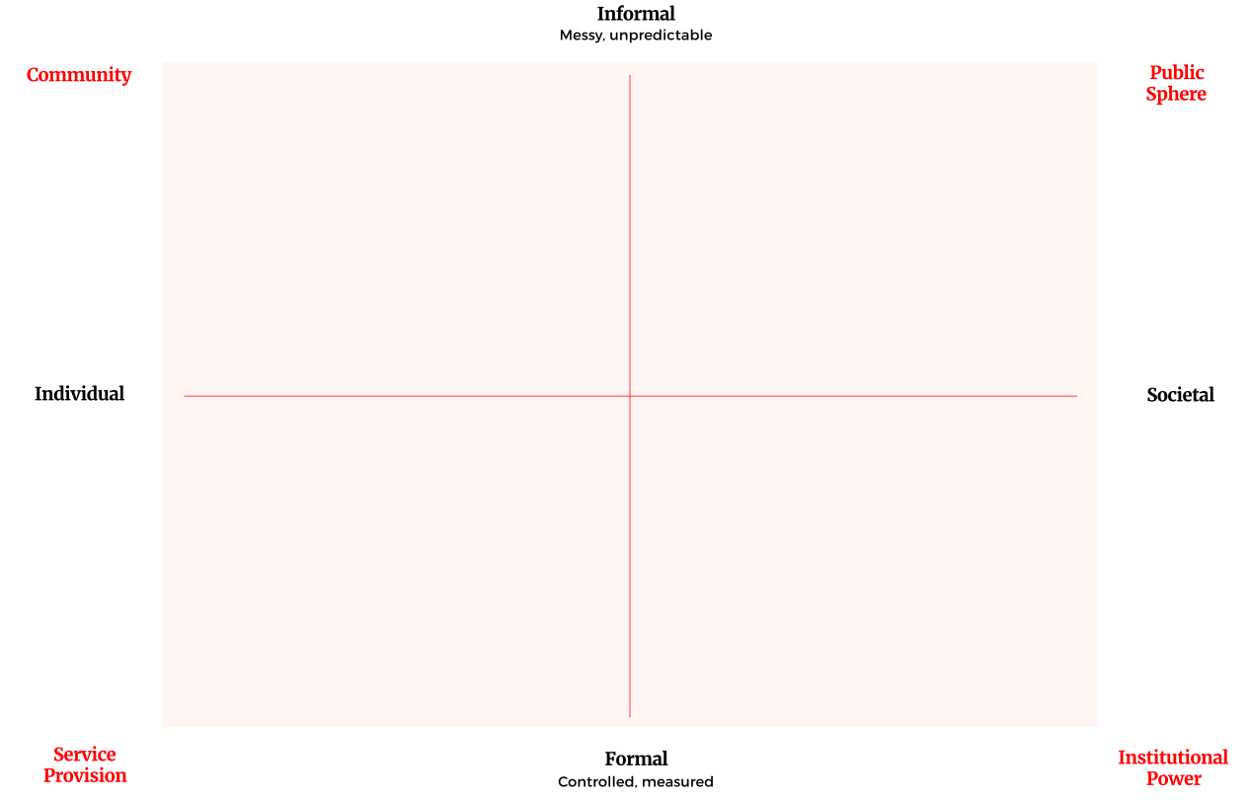
Extra resources: the Social Change Grid
Notes:
HANDOUTS PDF also provided

Slide 25
Extra resources: the Social Change Grid
SMK’s Social Change Grid can be used to help you think about the many different ways you can harness your own and others’ power to create change.
You can find a full explanation in the Social Power report, or in this bite-size guide.
Notes:
HANDOUTS PDF also provided

Slide 26
Extra resources: the 12 Habits of Successful Change-Makers
SMK’s 12 Habits of Successful Change-Makers are ways of thinking and behaving common to the most effective campaigners. Take time to reflect on how far you display each of them, and where you might like to do more.
You can find a full explanation in the Social Power report, or in this bite-size guide.
Notes:
HANDOUTS PDF also provided

Slide 27
Extra resources: Problem Tree
Take time to explore what problem you are really trying to solve. This tool will help you to discuss its causes and effects, helping you to focus on the solutions you think are most important.
Then flip it to describe the positive vision you are working towards.
Notes:
HANDOUTS PDF also provided

Slide 28

THE PROBLEM TREE
Social embarrassment
Heat or eat
Children’s education suffers
Poor health and wellbeing
The effect/impact
Problem debt
Winter deaths
The problem
Fuel poverty
Political
priorities
Energy market regulation
The root cause
Financial education
Social security system
Poor
housing stock
Lack of influence of people affected
Notes:
1 hour
Problem Tree Analysis – getting to the root of problems
Useful way to sit down and interrogate the problem. It can:
Help you check that you are, in fact, tackling the problem you want to tackle
Ensure you have thought about all potential causes – not just the one uppermost in your mind
Offer material for your messaging (covering tomorrow)
Generate ideas about different angles to tackle an issue from
Be a starting point for refining ‘what good looks like’
Can be simple or complex – best tackled as a group
START FROM THE POV OF PEOPLE AFFECTED

Slide 29
Social Change & Campaigning: podcasts
Podcasts are a free way to explore change and get inspiration. Here are just a few:
Social Power – SMK’s own podcast. We bring people together to explore instances of change. How did it feel? What did it look like? What can we learn?
Reasons to be cheerful – focuses on solutions and examples of progress – very heartening!
Just Cause – Derek Bardowell talks to people tackling social challenges and opening the doors for marginalized people to move to the centre
How to Fail – Elizabeth Day finds out how lots of very successful people failed and what they learned

