Slide 1

Developing a measure of 'Left-behind' areas Phase 2
Data analysis and summary report

Slide 2
Executive summary
Introduction
This report explores the socio-economic characteristics of 'Left-behind' areas, and compares the performance of 'Left-behind' areas, against other deprived areas and national benchmarks.
The introduction provides a brief overview of the history of the project and its phases, as well as a high level summary of the definition of ‘Left-behind areas.
Community Needs Index
The next section explores the Community Needs Index component of the 'Left-behind' measure, looking at spatial patterns and relationship with overall levels of deprivation and the Brexit vote.
Clear spatial patterns emerge, with relatively high levels of Community Need in the East of England, the industrial areas of the East Midlands and South Yorkshire, and County Durham and in the Thames Gateway and coastal communities throughout England.
There is some evidence of an association between deprivation and Community Need, with areas ranked as having higher levels of Community Need, having higher average levels of deprivation; however, there are a notable number of outliers.
There is a strong correlation between Community Need and the propensity to vote leave in the EU elections, this relationship is markedly stronger than the relationship between overall levels of deprivation and the Brexit vote
Location of 'Left-behind' areas
There are some clear spatial patterns in terms of the geographic location of 'Left-behind' areas, with high concentrations in the periphery of major urban areas in the North and Midlands and in towns along the East coast. By contrast, there are relatively few of these areas in London, or in inland areas of Southern England.
The overwhelming majority of 'Left-behind' areas are located in urban England, with only 3% of people in 'Left-behind' areas living in rural communities.
There are relatively high concentrations of 'Left-behind' areas in post-war social housing estates.

Slide 3
Executive summary
Key socio-economic findings
There are notably fewer job opportunities locally when compared against other deprived areas, leading to people needing to travel further for employment. This is a particular challenge as car ownership is relatively low and public transport times to employment centres are longer than the average across other deprived areas.
This is closely associated with the high levels of unemployment in these areas – the unemployment rate is more than double the national average and the gap has been growing in recent years.
Moreover, 'Left-behind' areas are performing less well than other deprived areas – the unemployment rate in 'Left-behind' areas was below that of other deprived areas prior to 2008; however, unemployment rose more sharply in 'Left-behind' areas following the 2008 financial crises and has remained higher than across other deprived areas ever since.
This poor performance is reflected in other socio-economic trends, for example 'Left-behind' areas are falling behind other deprived areas in terms of achieving reductions in levels of child poverty, with just under one-in-three children in the 'Left-behind' areas living in poverty.
For those in work, pay is lower than across other deprived areas and a higher proportion of people are engaged in low-skilled occupations. This reflects the relatively low skill profile of people living in 'Left-behind' areas, relative to other deprived areas, with 36% of people possessing no formal qualifications (compared with 31% in other deprived areas) and 12% of adults educated to degree level in 'Left-behind' areas compared with 18.4% across other deprived areas and more than 27% across England as a whole.
Another driver of high levels of poverty in the area is the relatively poor health outcomes, with self-reported levels of limiting-long-term illness are relatively poor across all age groups and a higher than average prevalence of people with poor health conditions, linked to a higher proportion of people are engaged in risky health behaviours (smoking, binge drinking, low levels of fruit and vegetable consumption). 'Left-behind' areas are also report higher instances of mental health related challenges, when benchmarked against other deprived areas across a range of recorded measures.
Poor health outcomes are reflected in the high proportions of people receiving DWP benefits due to poor health or caring responsibilities.
Moreover, despite the higher levels of need in 'Left-behind' areas, average levels of funding per head for Local Government services are not only lower than the average across deprived areas, but lower than the average across England as a whole.
In conclusion, the analysis shows that 'Left-behind' areas face a range of complex socio-economic challenges and there is some evidence to suggest they are falling further behind other deprived areas, as they lack the community and civic infrastructure to mitigate the impacts of these challenges.

Slide 4
Introduction
About this research
Analysis of the spatial distribution of 'Left-behind' areas is a growing concern for social policy with a range of studies starting to explore underlying factors contributing to areas being 'Left-behind' – including low levels of social mobility, low skills or declining industries and exclusion from external investment by the public and voluntary sector. Local Trust have commissioned OCSI to provide a quantitative definition of 'Left-behind' areas.
This report is the final output in the second phase of the project – and presents a baseline evidence base for the revised Phase 2 'Left-behind' areas. The Phase 2 'Left-behind' areas were developed following consultation with key stakeholders to refine the model methodology and component indicators proposed in Phase 1 of the project. These changes have produced a revised list of 'Left-behind' areas which are presented in this report. The report compares the performance of the Phase 2 'Left-behind' areas on key socio-economic indicators against the performance in other deprived areas which have not been identified as 'Left-behind' and in the context of England as a whole.
This report is accompanied by the Domains and indicators in the Phase 2 Community Needs Index report which outlined the revised set of key socio-economic indicators and domains which were used to produce the Community need Index component of the 'Left-behind' areas measure.
Structure of the report
The report is divided into the following sections:
Methodology
Community Needs Index
Location of 'Left-behind' areas
Population
Housing
Economy
Deprivation
Health
Crime
Education and skills
Access and services

Slide 5
Methodology

Slide 6
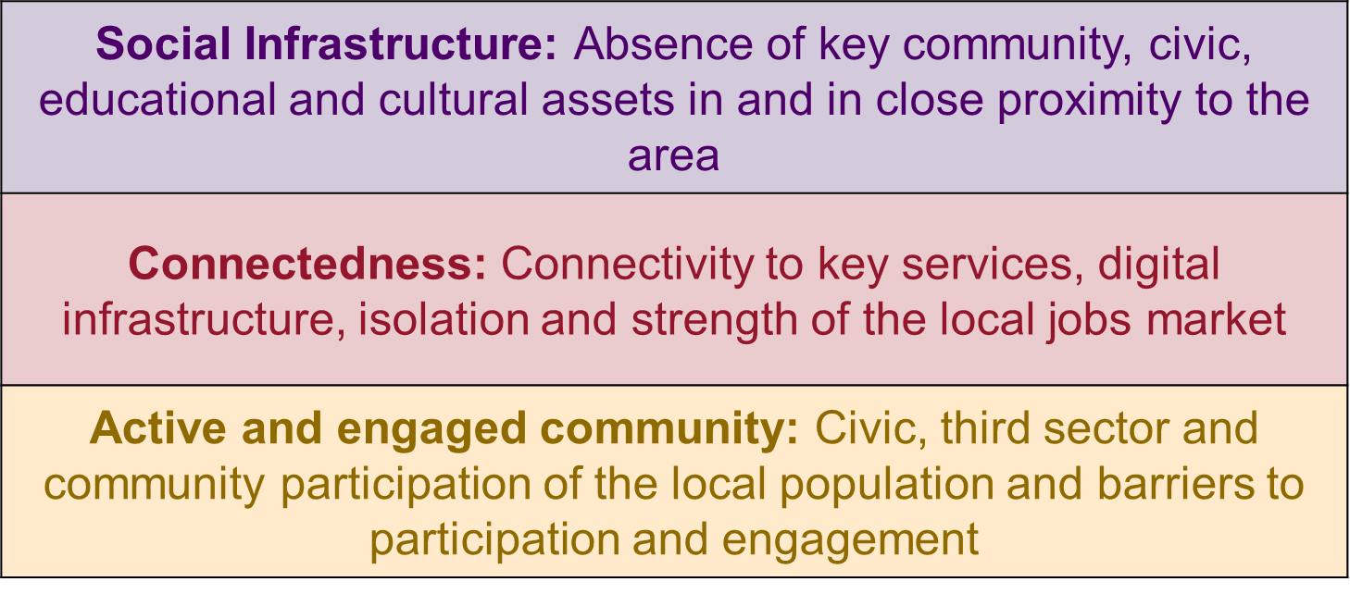
Identifying 'Left-behind' areas – about the measure
'Left-behind' areas are conceptualised as areas with
high levels of need, multiple deprivation and socio-economic challenges
poor community and civic infrastructure, relative isolation and low levels of participation
A Community Needs Index was developed to identify areas experiencing these second set of challenges by combining a series of 19 indicators, conceptualised under three domains:
The Community Need Score was combined with the 2015 Index of Multiple Deprivation (IMD), with wards that were ranked among the most deprived 10% on both the Community Needs Measure AND the IMD identified as 'Left-behind' areas.
We will explore the geographical distribution of the Community Needs Index and it’s relationship with overall levels of deprivation in the next section, before going on to look in more detail at the socio-economic challenges experienced in the areas identified as ‘Left-behind’.

Slide 7
Community Asset indicators
Indicator | Details | Source
Density of Community Space assets | Community and civic assets which fall inside or within 1km of the community boundary per 1,000 population (in the community). The following assets are included: • Public / Village Hall / Other Community Facility • Youth Recreational / Social Club • Church Hall / Religious Meeting Place / Hall • Community Service Centre / Office • Place Of Worship | Address base
Density of Education assets | (As above) The following assets are included: • College • Further Education • Higher Education • Children’s Nursery / Crèche • First School • Infant School • Junior School • Middle School • Primary School • Secondary / High School • Non State Secondary School • Secondary School • University • Special Needs Establishment. • Other Educational Establishment
Density of Sport and Leisure assets | (As above) The following assets are included: • Public House / Bar / Nightclub • Activity / Leisure / Sports Centre • Skateboarding Facility • Recreational / Social Club(Bingo)
Density of Cultural assets | (As above) The following assets are included: • Library • Reading Room • Museum/Gallery
Green Spaces | 1) Density of green assets: Green assets which fall inside or within 1km of the community boundary per 1,000 population • Public Park / Garden • Public Open Space / Nature Reserve • Playground • Play Area• Paddling Pool• Picnic / Barbeque Site• Allotment• Playing Field • Recreation Ground. 2) The percentage of an area that is covered by public parks and gardens. 3) Parks and open space/Landscape and natural heritage assets: •Number Parks and Gardens (Grade I, II & 3) per 10,000 population • Traditional Orchards per 10,000 population • Green Flag Parks (Heritage Award) per 10,000 population • National Park/ Heritage Coast (sq km per head) •Country Parks (hectares per head) • National Trust Land (always open to public) (hectares per head) • Blue Flag Beaches per 10,000 population •Area of Outstanding Natural Beauty (hectares per head) • Special Areas Conservation/ Special Protection Areas/Special Sites Scientific Interest/Local Nature Reserves/ National Nature Reserves/ Ramsar Wetlands/ Ancient Woodlands/ (hectares per head) •Wildlife Trust Reserves/• Ancient Trees per 10,000 population | 1. Address base 2. Ordnance Survey 3. Historic England/Natural England/Environment Agency/Keep Britain Tidy/Blue Flag/The Wildlife Trust/UNESCO/Woodland Trust

Slide 8
Connectedness indicators
Indicator | Details | Source
Jobs density in the Travel to Work Area | The number of jobs located in the local area as a percentage of the working age population in that area. Data is taken from the Business Register and Employment Survey (BRES) of approximately 80,000 businesses and weighted to represent all sectors of the UK economy. | Business Register and Employment Survey
Travel time (mins) to key services by public transport/walk | These statistics are derived from the analysis of spatial data on public transport timetables; road, cycle and footpath networks; population and key local services. The following services are included: • Primary School • Further Education • Secondary School • Hospital • Town Centre • Employment Centre • GP• Supermarket | Department for Transport
People living alone | Shows the proportion of households that are comprised of one person living alone (as a proportion of all households). Figures are self-reported and taken from the household composition questions in the 2011 census. This is included as a proxy measure of social isolation. | Census 2011
Households with no car | The proportion of households who do not have a car or van. Figures are based on responses to the 2011 Census car ownership question. | Census 2011
Broadband speeds | A composite indicator of the average broadband download linespeed (Mbit/s) for connections in the area and The percentage of broadband connections in the area that receive low download speeds (less than 2 Mbit/s). | Ofcom

Slide 9
Active and engaged community indicators (part 1)
Indicator | Details | Source
Voter turnout at Local Elections | Valid votes turnout (%) at the most recent Local Council Elections | Electoral Commission
Registered charities per head | Registered Charities in England by Postcode | Charities Commission
Big Lottery funding per head | Combined total of grants made to local projects and organisations by the Big Lottery Fund between 2004 and 2015 per head of population (£). Figures are taken from data on grants made to projects and organisations in local areas in the UK by the Big Lottery Fund, from ward grants data published by Big Lottery in conjunction with the 360Giving initiative. | Big Lottery (through 360 Giving)
Grant funding per head from major grant funders | Combined grant funding from grant giving organisations whose data has be subject to the 360giving standard. | 360 Giving Grant Nav data
SME lending by banks | Total value of lending to SME businesses from key financial lenders (Barclays, CYBG, Lloyds Banking Group, HSBC, Nationwide Building Society, Royal Bank of Scotland and Santander UK in Great Britain). | UK Finance
Arts Council Funding | Data on a range of arts council funding stream, location of national portfolio organisations are located and how much each organisation receives in funding. | Arts council England
Self-reported measures of community and civic participation | As part of the National Indicator Set programme, MHCLG collected a series of indicators relating to community and civic participation • Civic participation in the local area (The proportion of the adult population who say they have in the last 12 months participated in a group which makes decisions that affect their local area) • Percentage who have given unpaid help at least once per month over the last 12 months • Young people’s participation in positive activities (The proportion of young people in school year 10 reporting participating in any group activity led by an adult outside school lessons (such as sports, arts, music or youth group) in the last four weeks based on the analysis of the weighted) | Place Survey /TellUs Survey

Slide 10
Active and engaged community indicators (part 2)
Indicator | Details | Source
Strength of local social relationships | Self reported measures of strength of local social relationships: Calculated by combining responses to the following questions: "To what extent would you agree or disagree that people in this neighbourhood pull together to improve the neighbourhood?" "The friendships and associations I have with other people in my neighbourhood mean a lot to me." "I borrow things and exchange favours with my neighbours." "I regularly stop and talk with people in my neighbourhood." "I would be willing to work together with others on something to improve my neighbourhood." "If I needed advice about something I could go to someone in my neighbourhood." | Social Life (constructed from responses to the Community Life Survey and Understanding Society Survey)
Leisure and Cultural Participation a) Culture and Heritage participation | A combined indicator derived from responses to the Taking Part survey to produce the following indicators % of local authority population visiting heritage site at least 3 times in last 12 months % of local authority population visiting museum or gallery at least once in last 12 months % of local authority population visiting archive at least once in last 12 months | Taking Part survey
Leisure and Cultural Participation b) Participation in sport | This data shows the modelled estimated percentage of adults (aged 16+) who are classed as ‘active’. People are described as being active if they have done at least 150 minutes of moderate intensity equivalent (MIE) physical activity (excluding gardening) in the past week. Activity is counted in moderate intensity equivalent minutes whereby each ‘moderate’ minute counts as one minute and each 'vigorous' minute counts as two moderate minutes. Moderate activity is defined as activity where you raise your breathing rate, whereas vigorous activity is defined as doing activity where you are out of breath or are sweating (you may not be able to say more than a few words without pausing for breath). | Sport England (Active Lives Adult Survey)
For more details of the indicators included under these themes, please see the accompanying report: Domains and indicators in the Phase 2
Community Needs Index

Slide 11
Community Needs Index
This section explores which Local Authorities have the highest levels of Community Need and the relationship between Community Need and deprivation

Slide 12
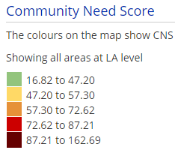
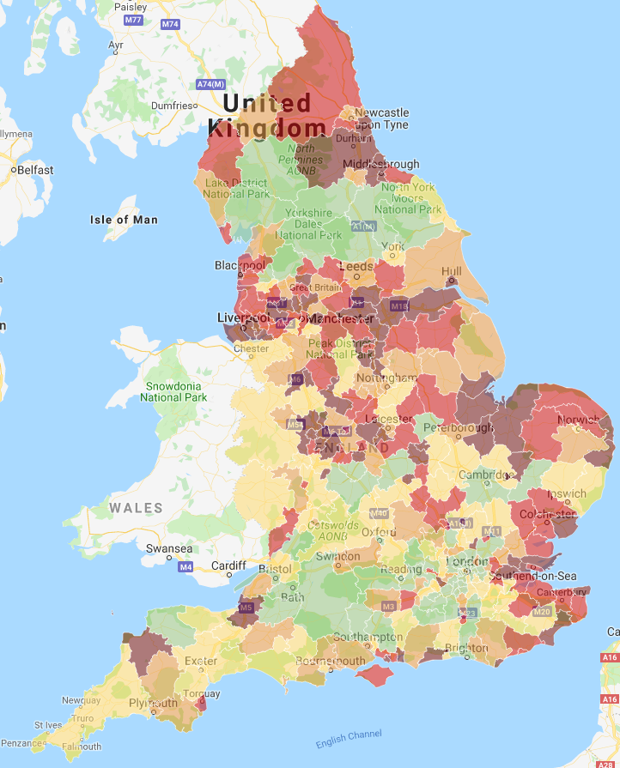
Where are the areas with the highest levels of Community Need?
The map on the right identifies the Local Authorities ranked by Community Needs Score.
Areas shaded dark brown have the highest levels of Community Need, while areas shaded green have the lowest levels of Community Need.
Local Authorities with the highest concentrations of Community Need can be found in the East of the country, particularly around the agricultural Fen areas near the Wash, The industrial areas of the East Midlands and South Yorkshire, and County Durham and in the Thames Gateway and coastal communities throughout England.
By contrast, the lowest levels of Community Need are typically found in areas in and around London, University towns and rural areas of Northern England around the major National Parks (Lake District, Yorkshire Dales and North York Moors).

Slide 13
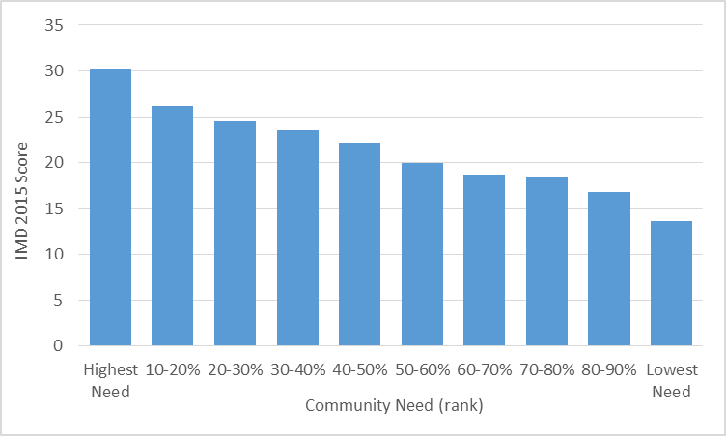
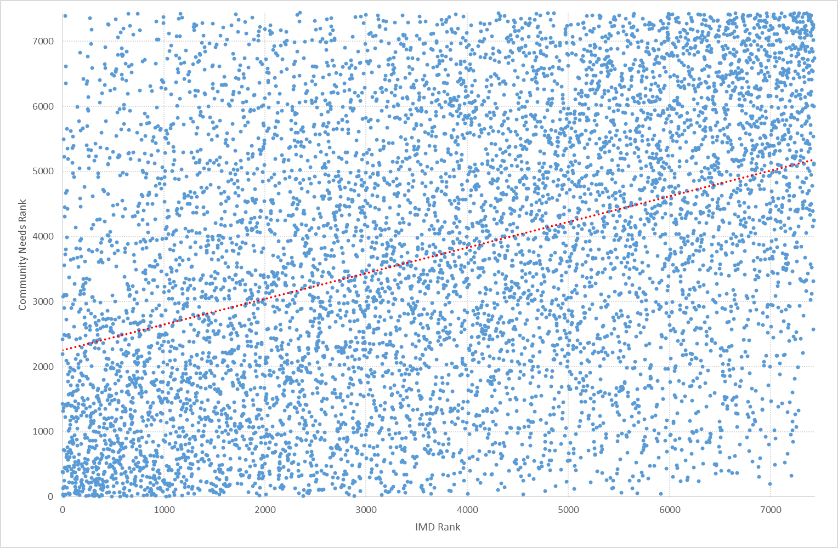
Relationship between Community Needs and Deprivation
The chart on the top right compares average levels of deprivation measured against overall levels of Community Need. The chart shows the range of deprivation (based on the Indices of Deprivation 2015 score) for Wards grouped into 10 per cent bands, or ‘deciles’, based on their Community Needs rank.
The chart shows that there is a strong relationship between deprivation and Community Need, with the 10% of wards with the highest levels of Community Need having the highest average deprivation score (30.1). This relationship is consistent across the decile groups i.e. the higher the level of Community Need, the higher the level of overall deprivation.
Overall, there is a slight but significant correlation of .394** (Pearson) between the Community Needs Score and IMD 2015 Score. However, there are a large number of areas where this relationship does not hold as strong. The chart on the bottom right scatters the IMD Score and Community Needs Score for each individual Ward in England.
The Chart shows that while there is a positive relationship between Community Need and levels of deprivation, there are a large number of areas classified as having high levels of Community Need and low levels deprivation and vice versa.
There are 112 wards (1.5%) ranked among the most deprived 20% on the IMD that are ranked among the least deprived 20% in terms of Community Need. By contrast, there are 126 wards (1.7%) ranked among the least deprived 20% on the IMD that are among the most deprived 20% in terms of Community Need.

Slide 14
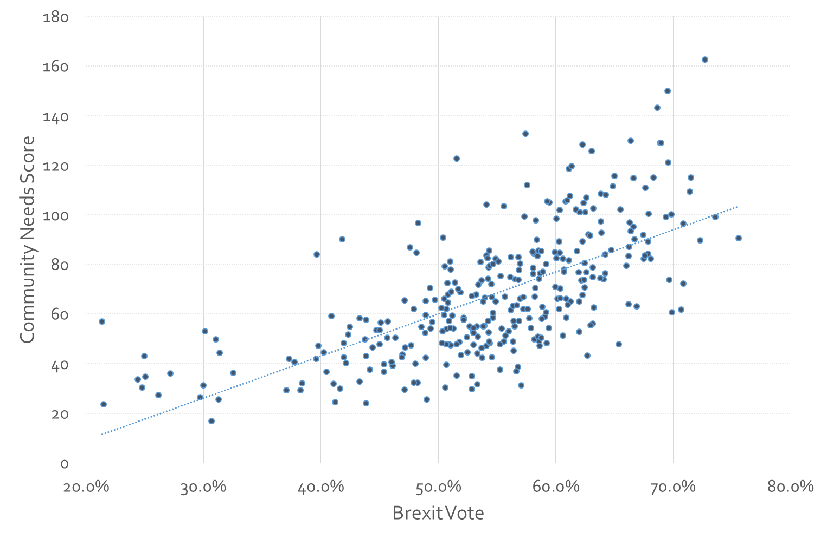
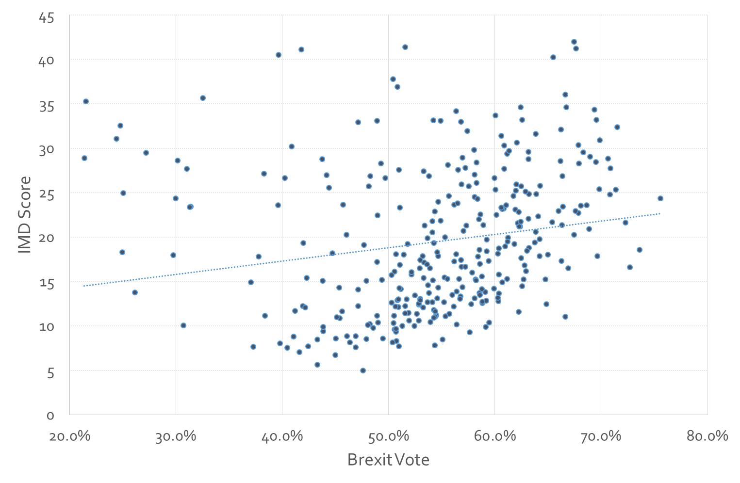
Community Need and Brexit
The chart on the top right compares the Community Needs score with the proportion of people who voted leave in the 2016 EU referendum. The chart shows that there is a strong positive relationship between Community Need Score and Brexit, with areas ranked as having a higher Community Need Score, more likely to vote to leave the European Union. There is a strong and significant overall correlation co-efficient of .66 (Pearson Correlation) between the Brexit vote and Community Needs Index Score at Local Authority level.
The association between Community Need and voting leave in the referendum is stronger than the correlation between deprivation and the leave vote. The chart on the bottom right compares the Index of Multiple deprivation 2015 average score at Local Authority level with the proportion of people who voted leave in the 2016 EU referendum. While there is a slight positive relationship, the association is less clear with a large number of outlier areas (areas, with high levels of deprivation which voted to remain in the EU). The overall correlation co-efficient between deprivation and the Brexit vote is .18 which is notably weaker than the correlation co-efficient between Community Need and voting leave.
Source: Electoral Commission 2016/MGCLG 2015

Slide 15
Location of 'Left-behind' areas
This section explores where the 'Left-behind' areas are located with maps produced for each region in England

Slide 16
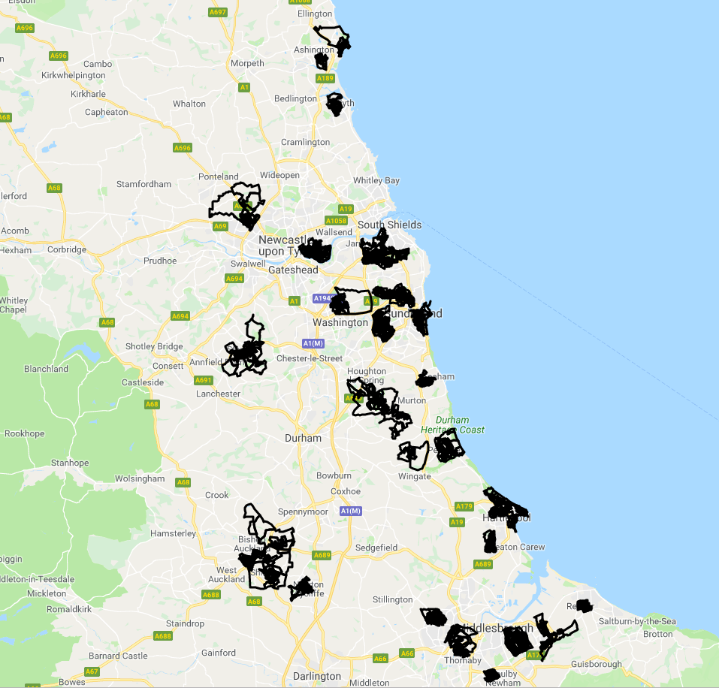
'Left-behind' areas in the North East are concentrated in former mining communities and fringe areas in Teesside and Tyne and Wear
The map on this page shows the location of 'Left-behind' areas in the North East region.
There are 45 wards in the North East classified as 'Left-behind', this represents 13.3% of the wards in the North East (the highest percentage of any region).
The highest concentrations are found in former mining communities around County Durham and Northumberland Coast – Easington, Peterlee, Shildon, Stanley Ashington, Blyth and Newton Aycliffe and around the periphery of larger towns in the region, including outlying housing estates in Sunderland, Middlesbrough, Stockton, Redcar and Hartlepool.

Slide 17
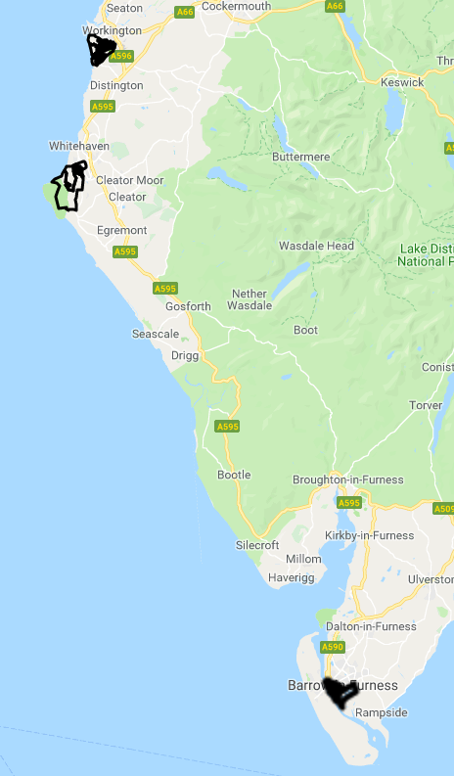
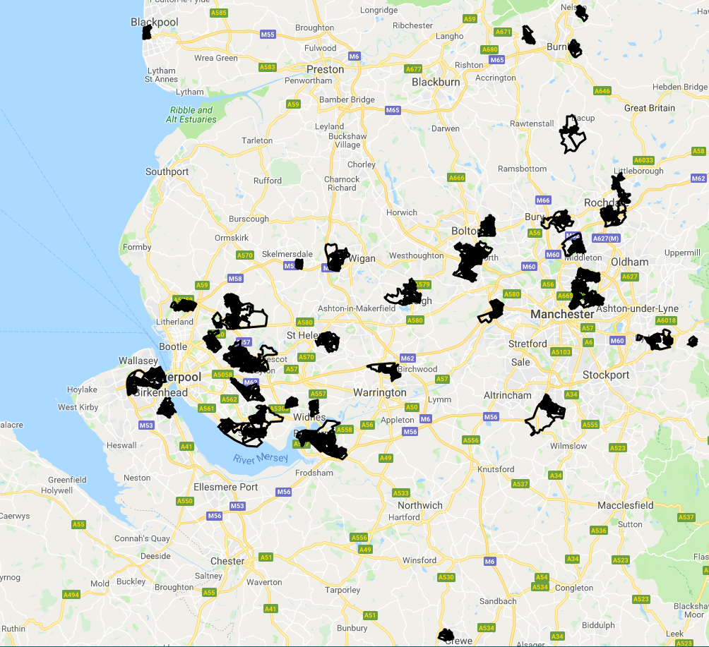
'Left-behind' areas in the North West are concentrated in the outlying areas of Greater Manchester and Merseyside, with additional concentrations in the fringes of Lancashire mill towns and the Cumbrian coast
The maps on this page show the location of 'Left-behind' areas in the North West region.
There are 52 wards in the North West classified as 'Left-behind' (the greatest number of any region), this represents 5.6% of the wards in the North West.
The highest concentrations are found in around the two largest conurbations in the region – Greater Manchester and Merseyside.
In Greater Manchester, the 'Left-behind' areas are clustered in outlying housing estates surrounding the city and its satellite towns including Harpurhey, Newton Heath, Leigh, and Little Hulton, Moses Gate. There are also concentrations around Liverpool in neighbourhoods including Speke and Norris Green as well as concentrations in smaller towns in the metropolitan area Runcorn, Kirkby, St Helens, Widnes, Skelmersdale and Wigan. There are also concentrations in coastal areas of Cumbria – Barrow, Workington and Whitehaven.

Slide 18
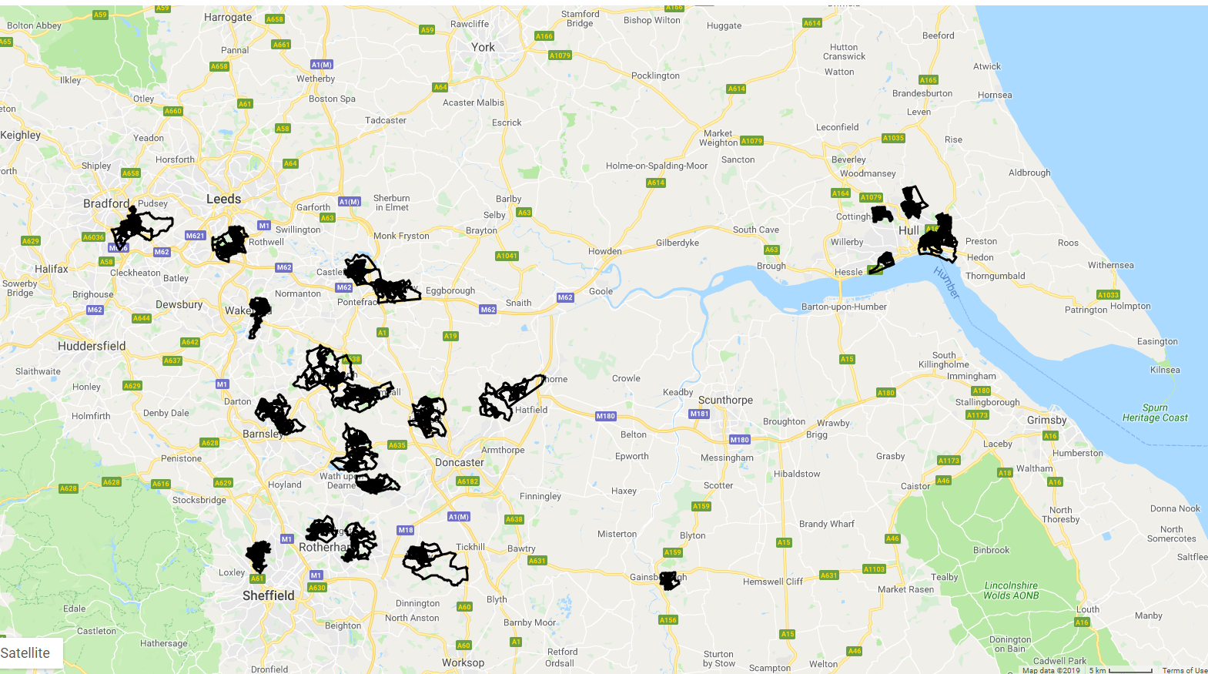
'Left-behind' areas in Yorkshire and the Humber are concentrated in outlying estates in the larger cities and towns
The maps on this page show the location of 'Left-behind' areas in Yorkshire and the Humber.
There are 26 wards in Yorkshire and the Humber region classified as 'Left-behind', this represents 5.6% of the wards in Yorkshire and the Humber.
The highest concentrations are found in the metropolitan Local Authorities of South and West Yorkshire including around Doncaster, Barnsley, Knottingley, Castleford, Maltby, and the outlying estates of the larger cities, Holme Wood (Bradford), Belle Isle (Leeds) and Bransholme and Marfleet (Hull).

Slide 19
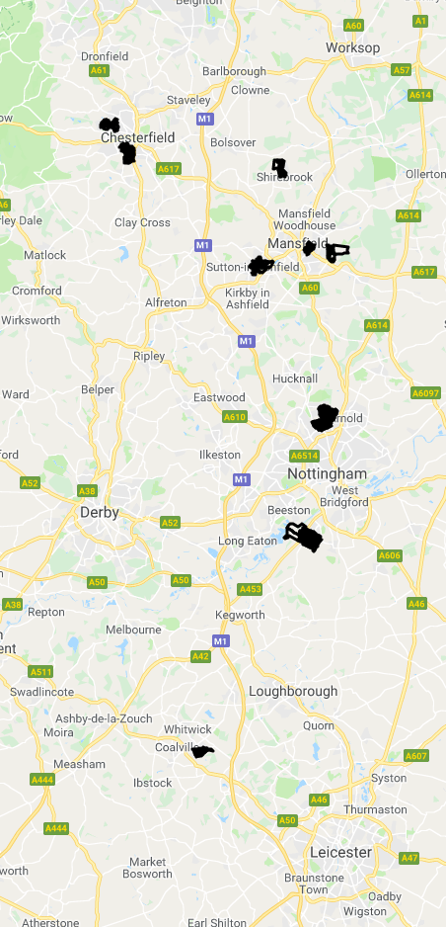
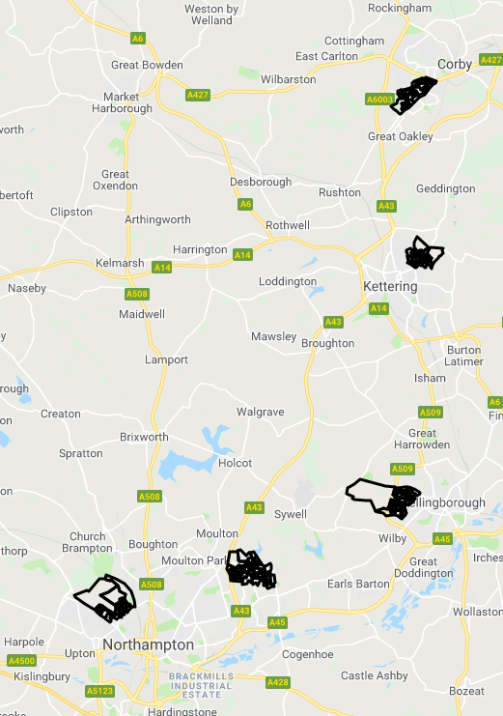
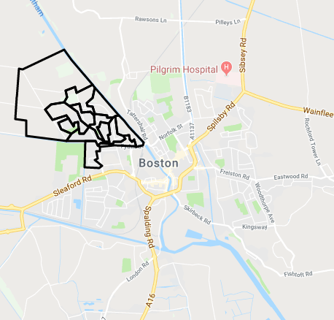
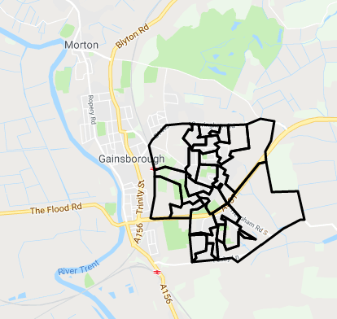
'Left-behind' areas in the East Midlands are concentrated away from the cities, in some of the larger towns throughout the region
The maps on this page show the location of 'Left-behind' areas in the East Midlands region.
There are 17 wards in the East Midlands classified as 'Left-behind', this represents 2.0% of the wards in the East Midlands.
There are no strong geographic concentrations of 'Left-behind' areas, with areas found in each of the counties. However, there are no 'Left-behind' areas in any of the four cities in the region (Nottingham, Leicester, Derby and Lincoln). By contrast, the highest concentrations are found in the major towns in the coalfield areas of Derbyshire (Chesterfield, Shirebrook) and Nottinghamshire (Mansfield, Sutton-in-Ashfield, the outlying housing estates in the largest towns in Northamptonshire (Northampton, Corby, Kettering and Wellingborough) and isolated pockets in small towns in Lincolnshire (Boston, Gainsborough).

Slide 20
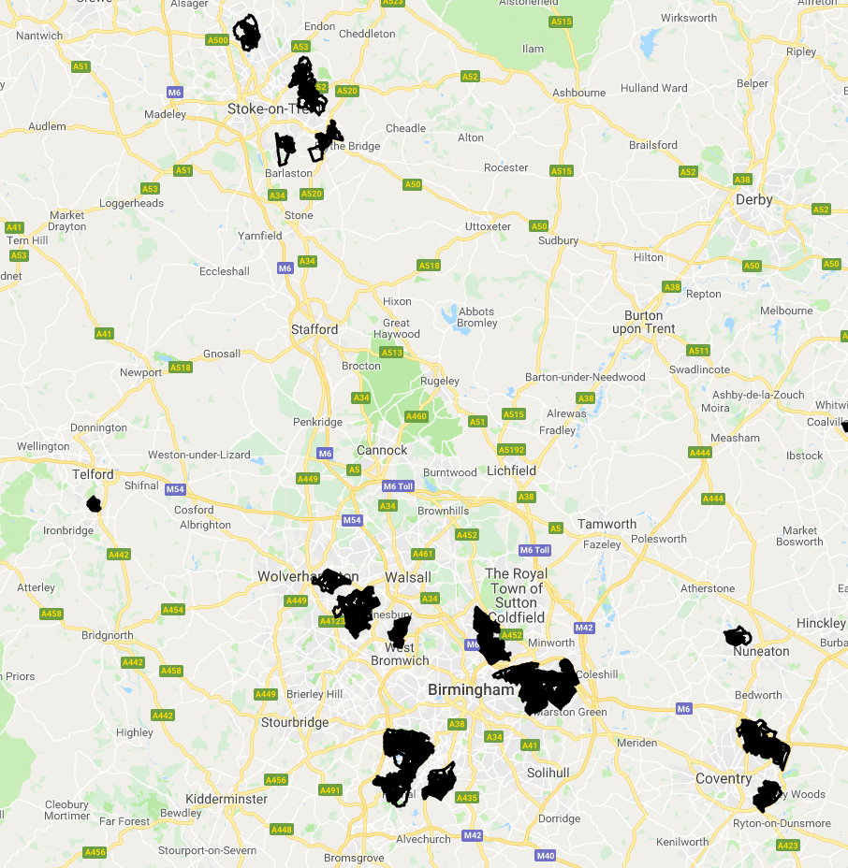
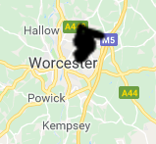
'Left-behind' areas in the West Midlands are concentrated in the outlying housing estates in the largest towns and cities (Birmingham, Coventry, Stoke, the Black Country, Telford and Worcester)
The maps on this page show the location of 'Left-behind' areas in the West Midlands region.
There are 30 wards in the West Midlands classified as 'Left-behind', this represents 4.0% of the wards in the West Midlands.
In contrast, to the East Midlands, the majority of 'Left-behind' areas in the West Midlands are located in the largest urban areas in the region with the highest numbers to be found in and around Birmingham. The highest concentrations in the area are in East Birmingham (Lea Hall/Shard end) and around South West Birmingham (Longbridge). 'Left-behind' areas are also present in the other large urban areas in the region: Coventry, Stoke-on-Trent, Wolverhampton, Sandwell, Telford and Worcester. By contrast, there were no 'Left-behind' areas in small towns or rural areas in the region.

Slide 21
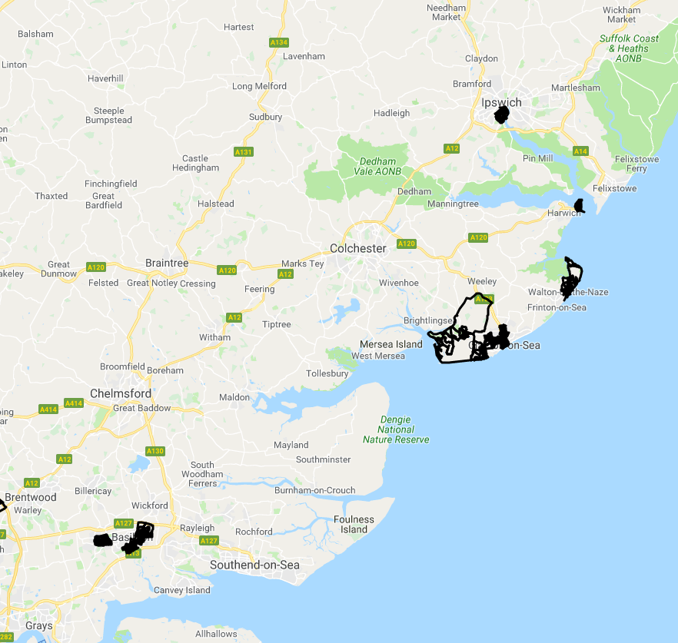
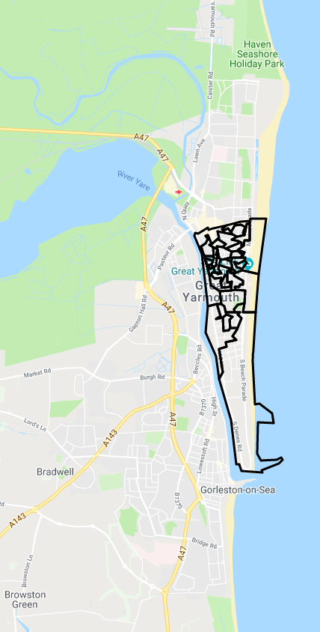
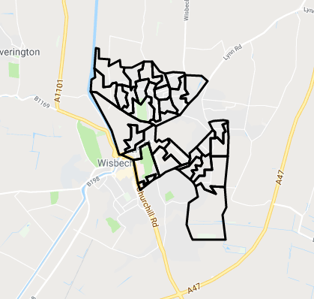
'Left-behind' areas in the East region are concentrated in seaside towns and around the Thames Gateway
The maps on this page show the location of 'Left-behind' areas in the East region.
There are 16 wards in the East classified as 'Left-behind', this represents 1.5% of the wards in the East region.
'Left-behind' areas in the region are concentrated along the East coast – in the seaside resorts of Great Yarmouth, Jaywick, Walton on the Naze and Clacton; and in the towns of Basildon, Ipswich, and Wisbech.

Slide 22
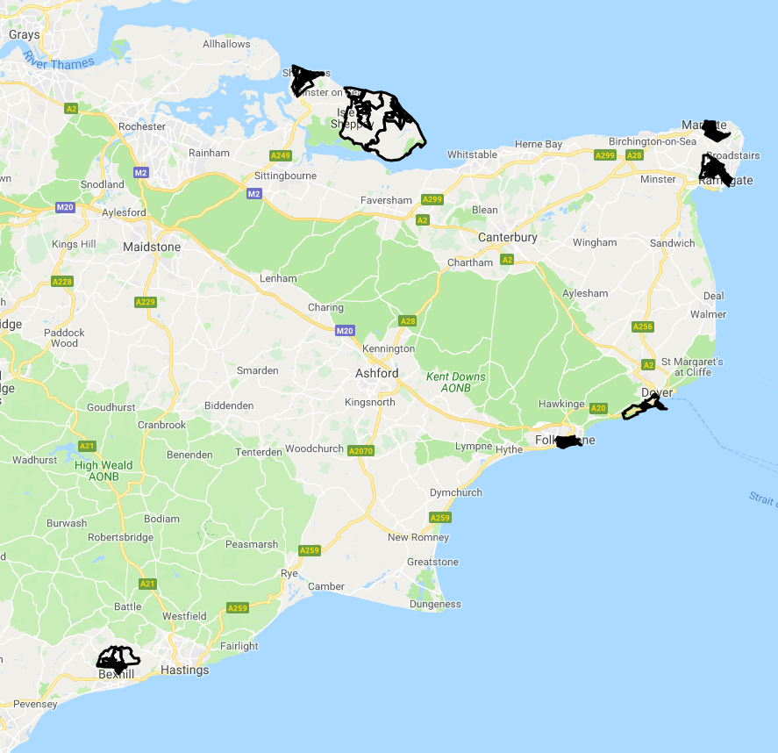
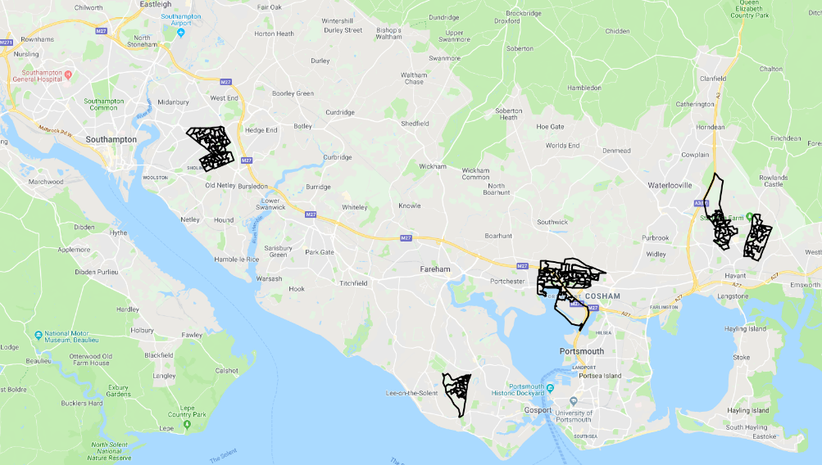
'Left-behind' areas in the South East region are concentrated in the North Kent coast and around the fringes of Portsmouth
The maps on this page show the location of 'Left-behind' areas in the South East region.
There are 15 wards in the South East classified as 'Left-behind', this represents 0.9% of the wards in the South East.
'Left-behind' areas in the region are concentrated around the Kent coast (Isle of Sheppey, Margate and Ramsgate, Dover and Folkestone) and around the fringes of Portsmouth and Southampton (North Havant, Paulsgrove and Gosport – Rowner, Thronhill).

Slide 23
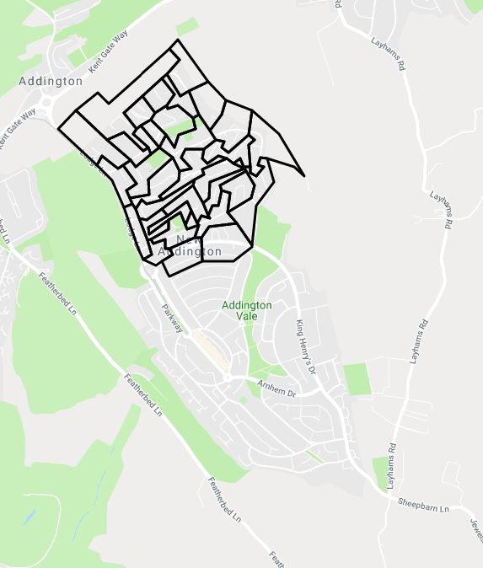
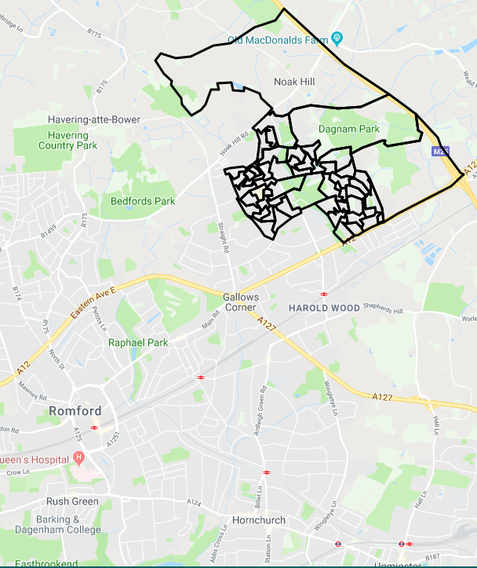
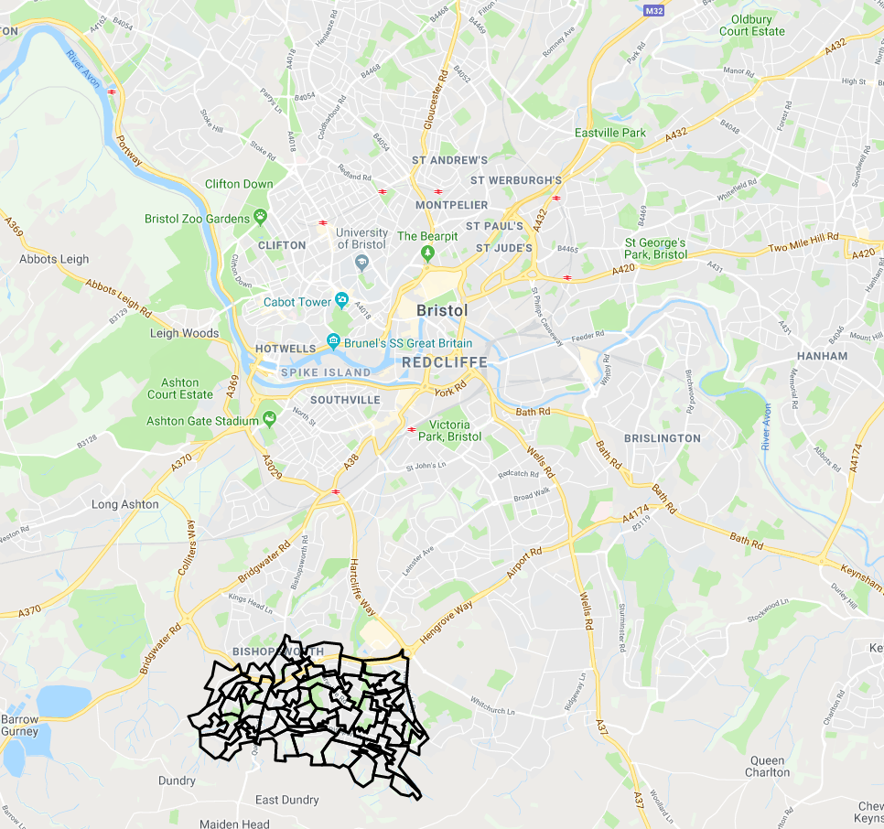
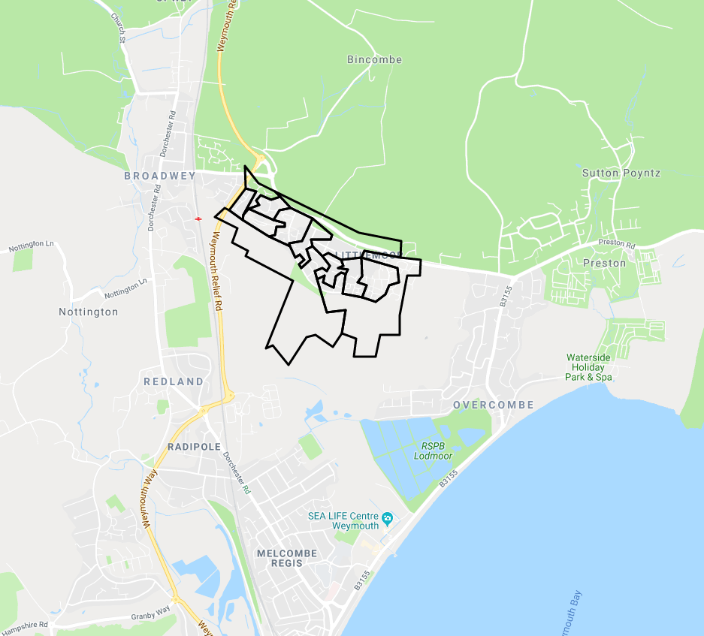
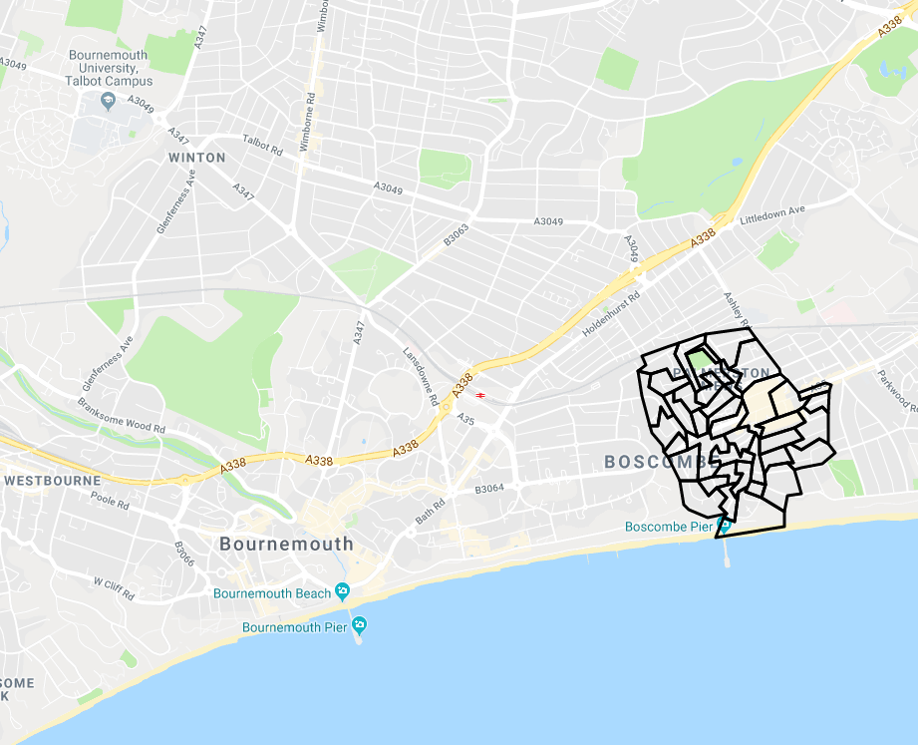
London and the South West regions have only a small number of areas identified as 'Left-behind’
The maps on the top right shows the location of the 'Left-behind' communities in London.
The 'Left-behind' communities is located in Gooshays on the outskirts of Romford in the borough of Havering and in Fieldway ward in New Addington (to the South of Croydon).
There are three wards in the South West region identified as 'Left-behind' (shown in the maps below) – Littlemoor on the outskirts of Weymouth, Hartcliffe and Withywood on the edge of Bristol and Boscombe West in Bournemouth.

Slide 24
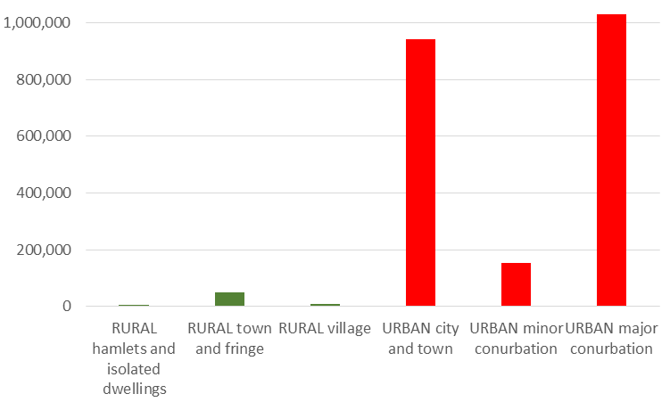
Only 3% of people in 'Left-behind' areas live in rural areas
The chart on the left shows the population in 'Left-behind' areas living in rural and urban areas
The chart shows the vast majority of areas classified as ‘left-behind’ are in urban areas, with 1,030,526 people (47% of all people in left-behind areas) living In Urban: major conurbations, 943,762 in Urban: city and town areas (43%), 153,698 in Urban: minor conurbations (7%), 50,158 in Rural: town and fringe areas (2.3%), 10,464 in Rural: village areas (0.5%) and just 4,844 in hamlets and isolated dwellings (the most isolated rural category.
People living in 'Left-behind' areas are much more likely to live in areas categorised as ‘Hard-Pressed Living’
Source: Office for National Statistics Rural Urban Classification (2011
The chart on the right looks at the characteristics of neighbourhoods across 'Left-behind' areas as defined using the Output Area Classification (OAC). OAC classifies every area in the country based on a set of socio-demographic characteristics, to provide a profile of areas to identify similarities between neighbourhoods.
The highest proportion of people in 'Left-behind' areas are also living in areas categorised as ‘Hard-pressed living’ according to the OAC classification (Mostly on the fringe of the UK's urban areas, particularly in Wales and the North of England. High levels of people in terraced accommodation, high unemployment, low ethnic diversity, high levels of people employed in manufacturing). Approximately half of people living in 'Left-behind' areas live in areas classified as ‘Hard-pressed living’, compared with 20% in other deprived areas and 17 % across England.
Source: Output Area Classification (2011)
Source: Office for National Statistics Output Area Classification (2011)

Slide 25
Population
This section explores the population characteristics of 'Left-behind' areas and how they differ to other areas across England

Slide 26
'Left-behind' areas have a relatively youthful population compared to England as a whole…
There are 2,193,000 people living in 'Left-behind' areas, of whom 48.7% are male and 51.3% are female.
The chart on the top right shows the age breakdown of the population.
Just under one in four people in 'Left-behind' areas (22.5%) are aged under 16 – similar to other deprived areas (22.5%) and slightly higher than England as a whole (19.1%). By contrast, 'Left-behind' areas have a lower proportion of people of working age (62%) than either deprived areas (66%) or England as whole (63%).
Source: Mid-Year Estimates (ONS) 2017
…with the population growing at a slower rate than across similarly deprived areas
The chart on the bottom right shows change in population across 'Left-behind' areas and their comparators between 2001 and 2017.
'Left-behind' areas have experienced a smaller population increase than their benchmarked areas, with the population remaining relatively stable until 2010 and with an average increase of approximately 5% between 2001 and 2017, compared with more than 17% in other deprived areas and 12% across England as a whole over the same period.
Source: Mid-Year Estimates (ONS) 2017

Slide 27
People living in 'Left-behind' areas are slightly less likely to be from ethnic minority groups than the national average…
The information boxes below show the number of people in White British, White Non British and Non-White Ethnic groups across 'Left-behind' areas and England as a whole.
White British
1,844,410
87.6% (England average = 79.8%)
Non-White
193,846
9.2% (England average = 14.6%)
White-non-British
68,133
3.2% (England average = 5.7%)
A higher proportion of people in 'Left-behind' areas identify as White British (88%) than the average across England (80%). However, a significant number of people living in 'Left-behind' areas are from BME communities (approximately 194,000 people).
…however, there are relatively high numbers of people from mixed white/black Caribbean ethnicity groups in 'Left-behind' areas
The chart on the right provides more detailed breakdowns of the population by ethnic minority group in 'Left-behind' areas and England.
The chart shows that while most ethnic groups are under-represented in 'Left-behind' areas, there are a higher proportion of people from Mixed White and Black Caribbean groups in 'Left-behind' areas compared with England as a whole.
Note, the variation in proportion of people from different groups is likely to be partly driven by the relative absence of 'Left-behind' community neighbourhoods in London which has a more ethnically diverse population than the other regions of England.
Source: Census 2011

Slide 28
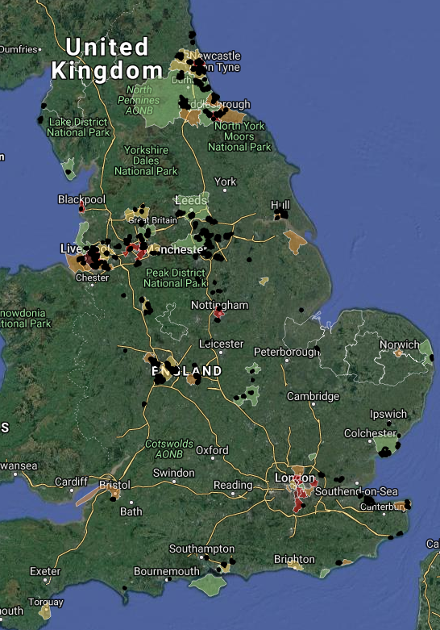
More than one-third (38%) of households with children in 'Left-behind' areas are headed by a lone parent – notably above the national average.
The chart below shows the composition of household types in 'Left-behind' areas, compared with the national average.
'Left-behind' areas are characterised as having higher levels of one-person households, cohabiting households and lone-parent family households compared with the national average.
Source: Census 2011
38% of households with dependent children are headed by a lone parent (compared with 34% in other deprived areas and 25% across England as a whole). The map on the right shows the areas with the highest proportion of lone parent households (shaded) with dependent children across England, with the location of 'Left-behind' areas overlaid (in black) – this shows a high degree of overlap between these categories.

Slide 29
Housing
This section looks into key housing trends in 'Left-behind' areas compared to other areas across England

Slide 30
More than half of people living in 'Left-behind' areas live in rented accommodation
The chart on the top right shows the tenure breakdown across 'Left-behind' areas, deprived areas (non 'Left-behind') and England as a whole.
The chart shows that less than 49% of people in 'Left-behind' areas own their own home, compared with more than 64% across England as a whole.
By contrast, 36.1% of people in 'Left-behind' areas are living in social rented housing, slightly above the proportion in other deprived areas (33.3%) and nearly double the proportion across England as a whole (17.7%). This reflects the concentration of 'Left-behind' areas in outlying social housing estates.
The chart below shows the age of accommodation across 'Left-behind' areas and comparators
The chart shows that a higher proportion of people in 'Left-behind' areas reside in post-war housing, with nearly 40% of dwellings in these areas built between 1945 and 1972, compared with 21% in Deprived non-'Left-behind' areas and 27% across England as a whole. This reflects the geographic distribution of 'Left-behind' areas, with a high concentration of 'Left-behind' areas in outlying social housing estates built in response to destruction of inner city Victorian housing during and in the aftermath of the Second World War.
By contrast, there are relatively small proportion of houses built this Millennium in 'Left-behind' areas - 9.3% of all dwelling stock was built after the year 2000, compared with 13% across other deprived areas and 12.6% across England as a whole. This is likely to be linked to the slow population growth in these areas.
Source: Census 2011

Slide 31
Economy
Exploring economic drivers within 'Left-behind' areas compared to other areas across England

Slide 32
There are substantially fewer local jobs available in 'Left-behind' areas compared with other deprived areas…
The charts below look at the local jobs market in 'Left-behind' areas and their comparators. The line chart compares the ratio of people who are unemployed vs number of job vacancies locally.
There are just under 10 unemployed claimants for every vacant job in 'Left-behind' areas compared with 5 in other deprived areas and 3.4 across England as a whole, highlighting fewer local job opportunities for those who are seeking employment in 'Left-behind' areas.
This is also seen in the chart below which compares the Jobs Density (number of jobs as a ratio of the working age population) in 'Left-behind' areas and their comparators.
There are just over 50 jobs in 'Left-behind' areas per 100 working age adults, compared with more than 88 per 100 in other deprived areas. This means that if working age adults were actively seeking work, only approximately half would be able to find work locally. This reflects the peripheral nature of 'Left-behind' areas compared with national comparators.
Source: Department for Work and Pensions/Job Centre Plus
Source: Business Register and Employment Survey (2017)

Slide 33
…with lower income levels on average…linked to a relatively high proportion of people engaged in low skilled occupations
The chart on the top left compares average household income levels (before and after housing costs) in 'Left-behind' areas and their comparators.
It shows that household income in 'Left-behind' areas is more than £7,000 lower on average than across England as a whole. The pattern when compared to other deprived areas is more complex, with a lower average household income in 'Left-behind' areas before housing costs are taken into account and higher average incomes after housing costs. This is likely to be linked to the geographic concentration of 'Left-behind' areas away from expensive housing markets e.g. London and the surrounding areas.
Source: Office for National Statistics (2015/16)
The chart on the bottom right shows the proportion of people living in 'Left-behind' areas and comparators in highly skilled (professional, managerial and associate professional) and low skill (elementary occupations).
The chart shows a higher proportion of people living in 'Left-behind' areas are engaged in elementary occupations (17.4%) and a lower proportion in professional occupations (24%) than other deprived areas. This is likely to be linked to the lower skill profile of these areas (see education section below).
Source: Census 2011
Largest industry sector
Manufacturing
15.3% of all people in employment
Second largest industry sector
Health
14.6% of all people in employment
Third largest industry sector
Retail industry
9.8% of all people in employment

Slide 34
Deprivation
Exploring deprivation in 'Left-behind' areas, compared to other areas across England

Slide 35
People living in 'Left-behind' areas are twice as likely to be unemployed as the national average…
The tables on the right compare the proportion of working age people receiving unemployment benefits (JSA and Universal Credit) in 'Left-behind' areas and comparators.
'Left-behind' areas have a higher proportion of people who are unemployed (6%) than across other deprived areas (5.3%) and England as a whole (2.6%). The unemployment rate is higher for young adults at 8.8%. This is likely to be linked to the relatively low levels of jobs opportunities available locally (see economy section above)
Unemployment Benefit (JSA and UC) claimants (Apr-19)
81,968
6.0% (England average = 2.6%)
Youth unemployment (JSA/UC) claimants aged 18-24) (Apr-19)
16,875
8.8% (England average = 3.6%)
Source: DWP
...with 'Left-behind' areas performing less well than other deprived areas in the last 10 years
The line chart on the left tracks the unemployment rate from 2004 to 2019 across 'Left-behind' areas and comparator areas.
The chart shows that in 2004, the unemployment rate was lower than across other deprived areas. However, during the financial crises of 2008, unemployment rose at a faster rate than the national average and has remained slightly higher than the across other deprived areas in subsequent years.
Source: DWP

Slide 36
Just under one-in three children in 'Left-behind' areas are living in poverty, higher than across other deprived areas and nearly double the national average…
The chart on the right compares the proportion of children living in out of work households, lone parent households and children in poverty in 'Left-behind' areas and comparator areas.
31.6% of children in 'Left-behind' areas are living in poverty, compared with 29.0% in other deprived areas and 16.8% across England. This is linked to higher levels of worklessness in 'Left-behind' areas with 31% of children in these areas living in families where all adults are out of work (compared with 25% in other deprived areas and just 14% in England as a whole).
Source: DWP
…with left-behind areas falling behind other deprived areas in terms of reducing child poverty
The line chart shows the year on year change in the proportion of children in out of work households. The chart shows that the relative position of 'Left-behind' areas has worsened in recent years, mirroring, the unemployment trends (as shown on the previous page).
In 2006 the proportion of children in out of work families was lower than across other deprived areas. However, by 2016 the position had reversed.
Source: DWP

Slide 37
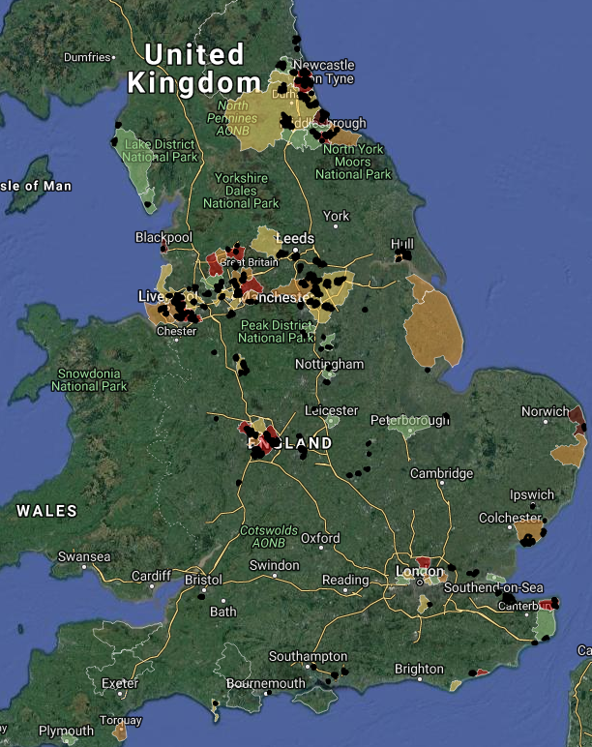
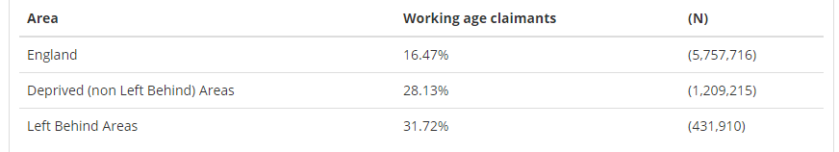
Just under one-in-three working age adults are in receipt of at least one welfare benefit – higher than across other deprived areas and nearly double the benefit claimant rate across England as a whole...
The table below shows the % of people receiving DWP benefits - payable to all people of working age (16-64) who need additional financial support due to low income, worklessness, poor health, caring responsibilities, bereavement or disability. The following benefits are included: Universal Credit. Bereavement Benefit, Carers Allowance, Incapacity Benefit/Severe Disablement Allowance, Income Support, Jobseekers Allowance, Pension Credit and Widows Benefit.
The data shows that 31.7% of working age people in 'Left-behind' areas are claiming DWP benefits, almost double the proportion across England as a whole (16.5%). The map on the right shows the Local Authorities with the highest proportion of working age benefit claimants (shaded) with dependent children across England, with the location of 'Left-behind' areas overlaid (with their boundaries shown in black).
As shown on the map, the 'Left-behind' areas are far more concentrated in Local Authorities which also have high levels of DWP benefit claimants.
Source: Department for Work and Pensions (DWP) May-18

Slide 38
...with particularly high levels of benefit receipt for reasons relating to work limiting illness and caring responsibilities.
The chart below shows a breakdown of working age DWP benefit claimants by reason for claim.
Approximately half of all benefit claimants are claiming due to work-limiting illness, in 'Left-behind' areas and the comparator areas alike.
'Left-behind' areas differ from their comparators in that they contain relatively high proportions of people receiving benefits due to illness and caring responsibilities. While the proportion of working age people claiming benefits due to unemployment is roughly similar across 'Left-behind' areas (2.6%) and other deprived areas (2.4%), the proportion claiming due to having a work limiting illness (11.7%), being a lone parent on low income (2.5%) or being a full time carer (3.4%) are notably higher than across other deprived areas (9.8%, 1.9% and 2.7% of working age people respectively in other deprived areas are in these three claimant groups).
Source: DWP, Nov 16

Slide 39
Health
Looking at common characteristics in health data for 'Left-behind' areas compared to other areas across England

Slide 40
'Left-behind' areas experience a lower life expectancy and a higher prevalence of limiting long-term illness than other deprived (non 'Left-behind') areas and England as a whole
The chart below compares male and female life expectancy across 'Left-behind' areas and comparator areas.
People living in 'Left-behind' areas can expect to live three years less than the national average.
The chart below shows the proportions of people in different age groups with a limiting long-term illness.
Just under one in four (24%) of people in 'Left-behind' areas have a long-term illness, higher than across other deprived areas (20%) and England as a whole (18%). This disparity is seen across all age groups. This is likely to be linked to the high levels of people receiving benefits related to poor health and caring responsibilities (noted in the deprivation section above).
Source: Office for National Statistics (2011-2015)
Source: Census 2011

Slide 41
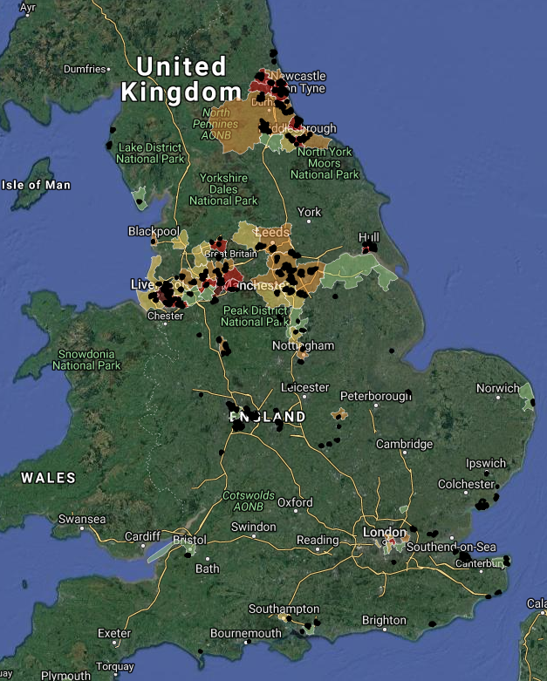
'Left-behind' areas experience considerably higher levels of lung cancer than the national average…
The chart below shows incidence of cancer (with breakdowns for the most common forms of cancer). The data is presented as an incidence ratio (ratio of observed incidence vs expected incidence given the age profile of the population).
Overall cancer incidence is higher in 'Left-behind' areas, with these areas showing a particularly high incidence of Lung Cancer (more than 60% above the national incidence rate).
Source: Office for National Statistics (2011/12-2014/15)
The map on the right shows the location of 'Left-behind' areas (shaded in black) overlaid with the areas with the highest incidence of Lung Cancer (coloured).
As can be seen on the map, there is a high degree of overlap between the concentration of 'Left-behind' areas and areas with the highest rates of lung cancer, with the highest overlap in the built up areas of Northern England.

Slide 42
…this is likely to be linked to higher rates of smoking, binge drinking and a lower rate of healthy eating in 'Left-behind' areas compared with other deprived areas and England as a whole….
The chart below shows the levels of smoking, binge drinking and healthy eating levels (consumption of five or more portions of fruit and vegetables a day among adults) in 'Left-behind' areas and comparator areas.
The chart shows that more than one-in-three (35%) of adults in 'Left-behind' areas smoke, notably above the smoking rates in other deprived areas (31%) and England as a whole (22%). By contrast, 'Left-behind' areas are less likely to be engaged in healthy eating than comparator areas with less than one-five people eating five or more portions of fruit and vegetables (19%), compared with 23% in other deprived areas and 29% across England as a whole. There is less disparity in levels of binge drinking, with a slightly higher prevalence seen in 'Left-behind' areas.
Source: Health Survey for England 2006-2008
…with a higher prevalence of poor health conditions in 'Left-behind' areas
The chart on the right shows the estimated prevalence of different health conditions in 'Left-behind' areas based on the number of people listed on GP registers in 2017/18. The chart shows that people living in 'Left-behind' areas experience particularly high level of Coronary Heart Disease, Diabetes, High Blood Pressure, Obesity and Kidney disease. This is likely to be linked to relatively high levels of smoking, drinking and lower levels of healthy eating identified above.

Slide 43
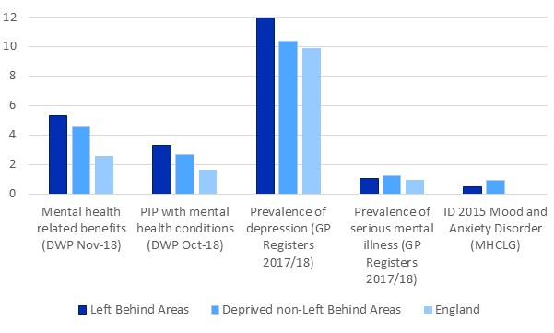
People living in 'Left-behind' areas are more likely to experience mental health conditions than across other deprived areas.
The chart below shows a series of indicators capturing the prevalence of mental health conditions in left-behind areas, deprived non-'Left-behind' areas and England. The Indices of Deprivation (ID) 2015 Mood and anxiety disorders indicator is a broad measure of levels of mental ill health in the local population. The definition used for this indicator includes mood (affective), neurotic, stress-related and somatoform disorders. The indicator is a modelled estimate based on four separate sources: prescribing data; hospital episodes data; suicide mortality data; and health benefits data. A higher score indicates that an area is experiencing high levels of deprivation. The estimated prevalence of a depression and serious mental health conditions are based on the number of people listed on GP registers in 2017/18, and the number of people recorded as having the relevant health conditions. Personal Independence Payments (PIP) is a non-means tested benefits to support the additional social care and mobility caused by long-term disability, ill-health or terminal ill-health. Incapacity Benefits are payable to those out of work with mental health conditions.
The chart shows that people living in 'Left-behind' areas are more likely to experience mental health issues than those living in other deprived areas on four of the five measures of mental health shown in the chart. There is a particularly high prevalence of depression among those living in 'Left-behind' areas, with 12% of people experiencing depression, compared with 10% in other deprived areas and England as a whole.

Slide 44
Crime
This section explores crime statistics in 'Left-behind' areas compared to other areas across England

Slide 45
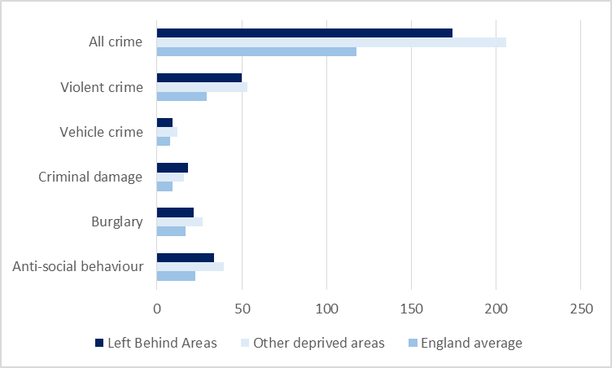
'Left-behind' areas experience higher crime than the national average for all major crime types, with notably high levels of criminal damage
The chart below shows rates of recorded crime (per, 1000 population) for key crime types across 'Left-behind' areas, other deprived areas and England as a whole in 2017/18.
The chart shows 'Left-behind' areas have a higher overall crime rate (174 per 1,000) than England as a whole (117 per 1,000), a pattern repeated across all major crime types.
However, the picture is less clear when comparing crime rates between 'Left-behind' areas and other deprived areas. 'Left-behind' areas have on average lower levels of violent crime and anti-social behaviour than non-'Left-behind' deprived areas. This is likely to be linked to their location in more peripheral areas (away from town centres and nightlife areas where these types of crime are more common). By contrast, 'Left-behind' areas have higher levels of criminal damage.
All crimes Sept17-Aug18
355,239
174.3 per 1,000 population (England average = 117.4)
Burglaries Sept17-Aug18
20,313
21.6 per 1,000 households (England average = 17.1)
Criminal damage incidents Sept17-Aug18
40,361
18.4 per 1,000 population (England average = 9.2)
Robberies Sept17-Aug18
3,479
1.6 per 1,000 population (England average = 1.4)
Vehicle crimes Sept17-Aug18
19,817
9.0 per 1,000 population (England average = 7.8)
Violent crimes Sept17-Aug18
109,983
50.1 per 1,000 population (England average = 29.1)
Anti-social behaviour incidents Sept17-Aug18
73,679
33.6 per 1,000 population (England average = 22.5)
45
Source: https://data.police.uk/

Slide 46
Levels of violent crime offences are higher in 'Left-behind' areas than the England average and they are rising, which matches a national story
The charts on this page track monthly change in crime levels for three offence types across 'Left-behind' areas and comparators.
The charts highlight that different crime types are showing different trajectories. Levels of burglary and anti-social behaviour are falling across each area, and there is some evidence that the gap is narrowing between 'Left-behind' areas and England as a whole. By contrast, levels of violent crime are growing and the gap is widening between 'Left-behind' areas and the national average.
Source: Violent crime offences https://data.police.uk/
…by contrast, levels of Anti social behaviour and Burglary are dropping in line with the England average and other deprived areas
Source: Anti-social behaviour offences https://data.police.uk/
Source: Burglary offences https://data.police.uk/
46

Slide 47
Education and skills
Looking at qualifications and skills levels in 'Left-behind' areas compared to other areas across England

Slide 48
People in 'Left-behind' areas are more likely to have no qualifications and less likely to have degree level qualifications than across other deprived areas and less than half as likely to have high qualifications compared with the national average
The chart on the right shows that 36% of people have no qualifications in 'Left-behind' areas compared with 31% in deprived (non 'Left-behind') areas and 22% across England. Conversely, 12.4% of people have degree level qualifications in 'Left-behind' areas, notably below the figure for other deprived areas (19%) and less than half the England average of 27.4%.
The chart below shows the proportion of people turning 18 between 2010-11 and 2014-15 who went on to enter higher education.
It shows that a much smaller proportion of people in 'Left-behind' areas (19.9%) are entering further education than in other deprived areas (27.6%) and across England (37.5%).
People with highest qualification level 1
267,227
16.2% of working age people (England= 13.3%)
People with highest qualification level 2
267,606
16.2% of working age people (England= 15.2%)
People with highest qualification level 3
172,879
10.5% of working age people (England= 12.4%)
Source: Office for Students (OFS)
Source: Census 2011 (https://www.nomisweb.co.uk/census/2011/ks501uk)

Slide 49
Attainment levels amongst both primary school children and teenagers are lower in 'Left-behind' areas than the average across England...and the gap has widened in recent years
The information below shows the attainment outcomes of children in early years through to Key Stage 4 (GCSE).
The chart below shows the percentage of pupils achieving 17 Early Learning Goals and the percentage of pupils achieving a good level of development at Early Years Foundation stage.
It shows that on both accounts, children in 'Left-behind' areas are less likely to meet expected development standards than in other deprived areas and other areas across England.
Average point score at Key Stage 4 (GCSE)
Source: Department for Education (2013-2014)
The chart below shows the changing gap in pupil attainment at GCSE between 'Left-behind' areas and the national average.
It shows that 'Left-behind' areas have consistently performed at below the national average, and while they were initially showing signs of closing the gap, there has been an increase in the attainment gap between pupils in 'Left-behind' areas and their peers in recent years.
Source: Department for Education (2013-2014)

Slide 50
Access and services
Access to services and transport in 'Left-behind' areas compared to other areas across England

Slide 51
Households in 'Left-behind' areas are less likely to own a car than the average across England...
The chart on the right shows details of the proportion of households in 'Left-behind' areas with no car and by number of cars owned.
It shows that 40.4% of households in 'Left-behind' areas have no car or van, compared to 25.8% across England. The proportion of people with no car is lower than across other deprived areas. However, 'Left-behind' areas are typically more likely to be located in peripheral locations than across other deprived areas, so they have longer travel times to access key services and employment opportunities.
…with longer travel times to key services by walking and public transport than across other deprived areas
The chart on the left shows average travel time in minutes to key services by walking and public transport.
The chart shows that while travel times to key services are in most cases, similar or lower than the national average - partly a reflection of the fact that a higher proportion of 'Left-behind' areas are urban than the national average (see location section above) – 'Left-behind' areas face longer average travel times to all key services than across other deprived areas.
Source: Census 2011

Slide 52
'Left-behind' areas receive lower levels of funding than other deprived areas and England as whole, despite higher average levels of need
The chart on this page shows the core spending power - the overall revenue funding available for local authority services per head of population from the Local Government finance settlement 2018/2019.
It shows that 'Left-behind' areas receive on average £832 per head to spend on core Local Government services, compared with £849 across other deprived areas and England as a whole. This shows that despite higher overall levels of need in 'Left-behind' areas, these areas are receiving lower levels of resources for local services.
Source: Census 2011

